Slide 1


Scrap-Vend
TEAM MEMBERS
Mohammad Noman
Aishwarya Phulwani
Poornima Varshney
Saif Ali
Guided By
Miss. Rozy Verma

Slide 2

Table of Content
1
Introduction
2
Modules Divided
3
Layout Design
4
QUERIES
5
References

Slide 3

Introduction
The main purpose of our web application is to ensure that all the scrap are managed in such a way that it protects both public health and environment by providing an ease to the people so that they can also contribute in the cleanliness of the surroundings without working hard and spending much time.
We provide the service to collect scrap material from your location and sell it to the recycling companies with market rates to help both.

Slide 4

MODULES DIVIDED
User
Login/Registration
Request/Cancel pickup
Edit profile
Contact us
Admin
Add/Remove items
Edit pricing scheme
Add/Remove pickup person
Schedule pickup
Add/Remove Company
Add Sales Information
Pickup Person
Pickup Status
Payment Mode

Slide 5
QUERIES
SELECT user_details.Username,login_info.contact_no,user_details.Address,booking_details.Pickup_date_time FROM ((`user_details` INNER JOIN `booking_details` ON user_details.User_id = booking_details.User_id) INNER JOIN `login_info` ON user_details.Username = login_info.Username) WHERE booking_details.Pickup_person_id='1';
UPDATE `item_details` SET `Item_name`=\"" + Name + "\" ,`Item_rate`=" + Rate + ",`Item_measure`=\"" + Measure + "\" WHERE Item_id = " + getItemId + " “;
INSERT INTO `item_details`(`Item_name`, `Item_rate`, `Item_measure`, `Item_image`) VALUES (\'" + itemModel.getItemName() + "\' ," + itemModel.getItemRate() + ", \'" + itemModel.getItemMeasure() + "\' , \'" + bArray + "\')";
DELETE FROM `item_details` WHERE Item_id = " + getItemId + " ";

Slide 6
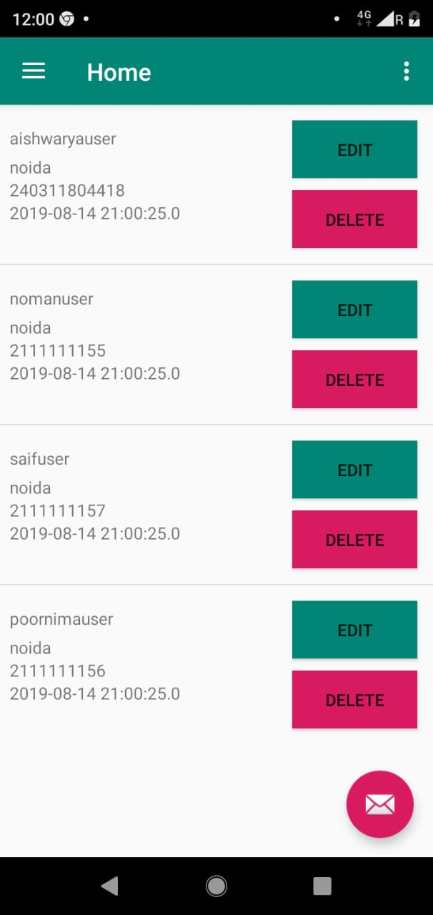
Pickup Person
Get a modern PowerPoint Presentation that is beautifully designed. Easy to change colors, photos and Text. You can simply impress your audience and add a unique zing and appeal to your Presentations. Get a modern PowerPoint Presentation that is beautifully designed. Easy to change colors, photos and Text. Get a modern PowerPoint Presentation that is beautifully designed.

Slide 7

Admin
Get a modern PowerPoint Presentation that is beautifully designed. Easy to change colors, photos and Text. You can simply impress your audience and add a unique zing and appeal to your Presentations. Get a modern PowerPoint Presentation that is beautifully designed. Easy to change colors, photos and Text. Get a modern PowerPoint Presentation that is beautifully designed.

Slide 8
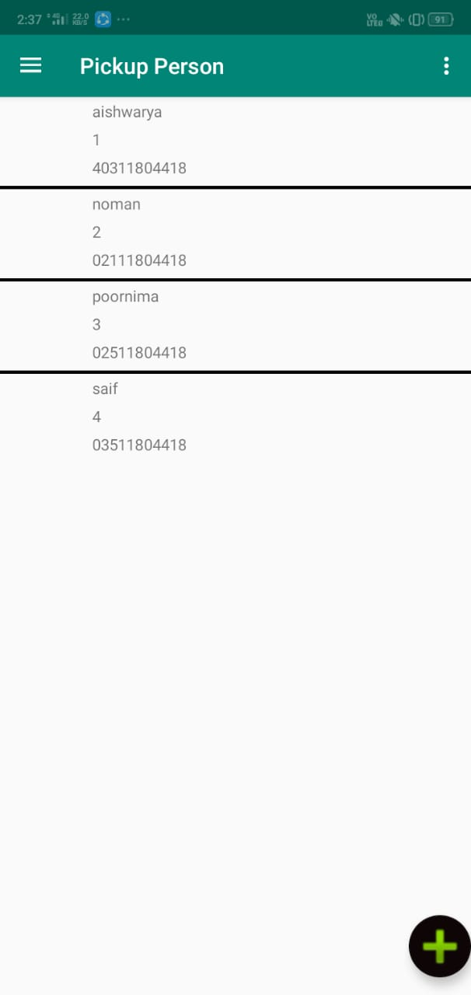
Admin

Slide 9
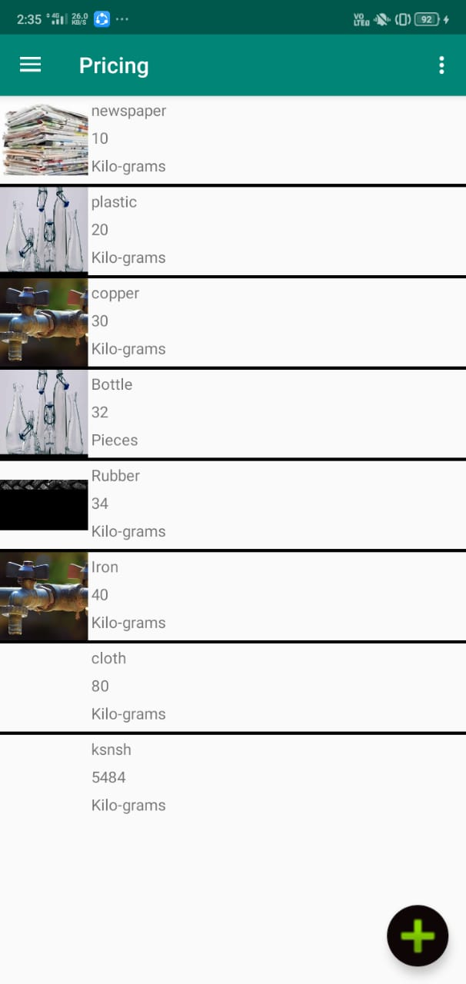
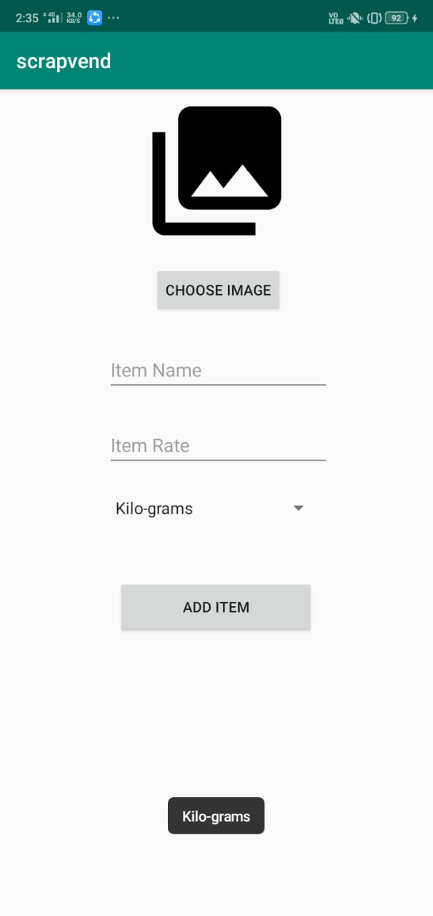
Admin

Slide 10
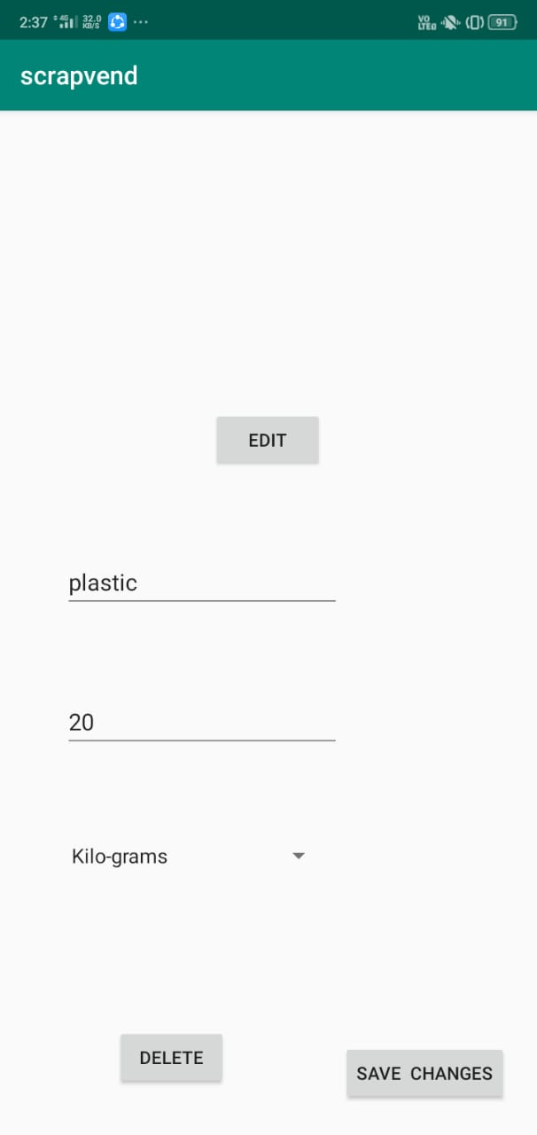
Admin

Slide 11
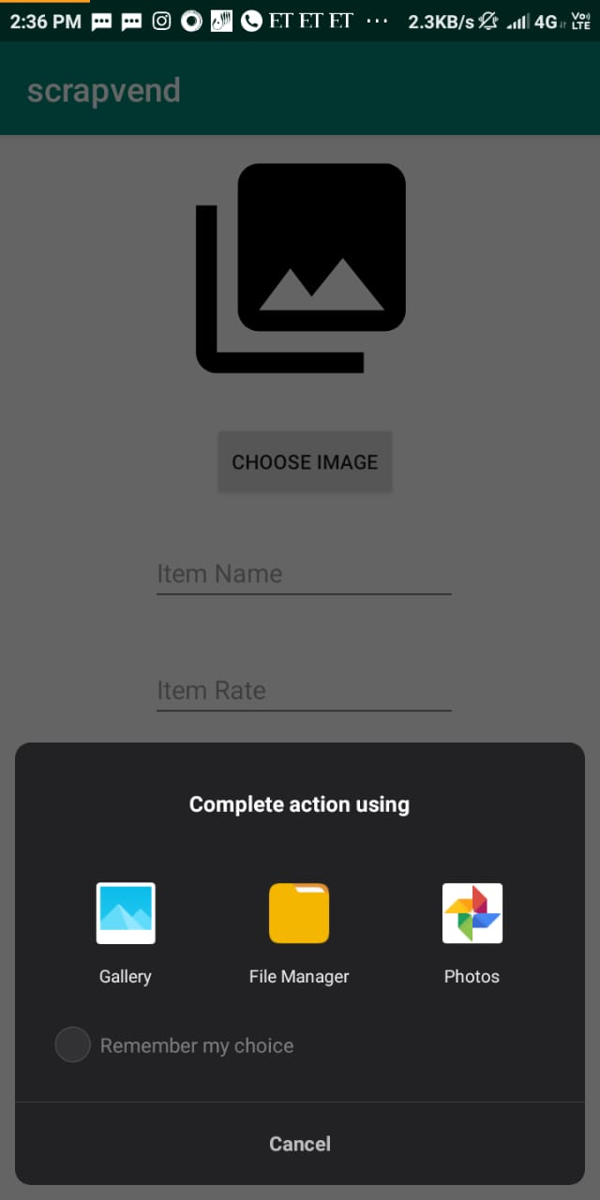
Admin

Slide 12
References
[1] https://www.Dbdesigner.net (Last accessed on 31/03/2019)
[2] https://www.comentum.com/guide-to-web-application-development.html (Last accessed on 01/04/2019)
[3] https://www.geeksforgeeks.org/html-tutorials/ (Last accessed on 31/03/2019)
[4] https://www.geeksforgeeks.org/css-tutorials/ (Last accessed on 31/03/2019)
[5] https://www.w3schools.com/html/default.asp (Last accessed on 31/03/2019)
[6] https://www.w3schools.com/css/default.asp (Last accessed on 31/03/2019)

Slide 13
Thank you
Insert the title of your subtitle Here

